Slide 1
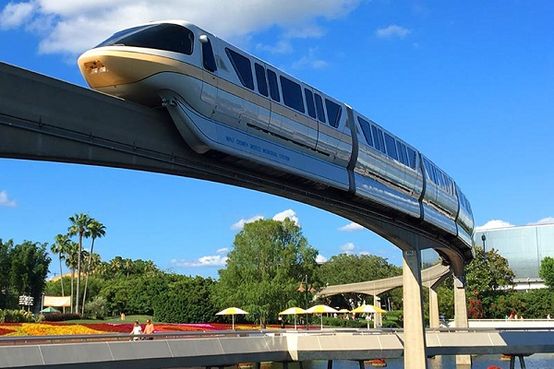
DELHI Mono RAIL(DMR)

Slide 2
Problem statement
Considering each station an integer value starting from 0 is assigned.
When the user enters the source station as a result, user can see the list of possible destination stations with the minimum number of stations between them.
You have to store information about the stations and their connections as given in the diagram in appropriate data structure.

Slide 3
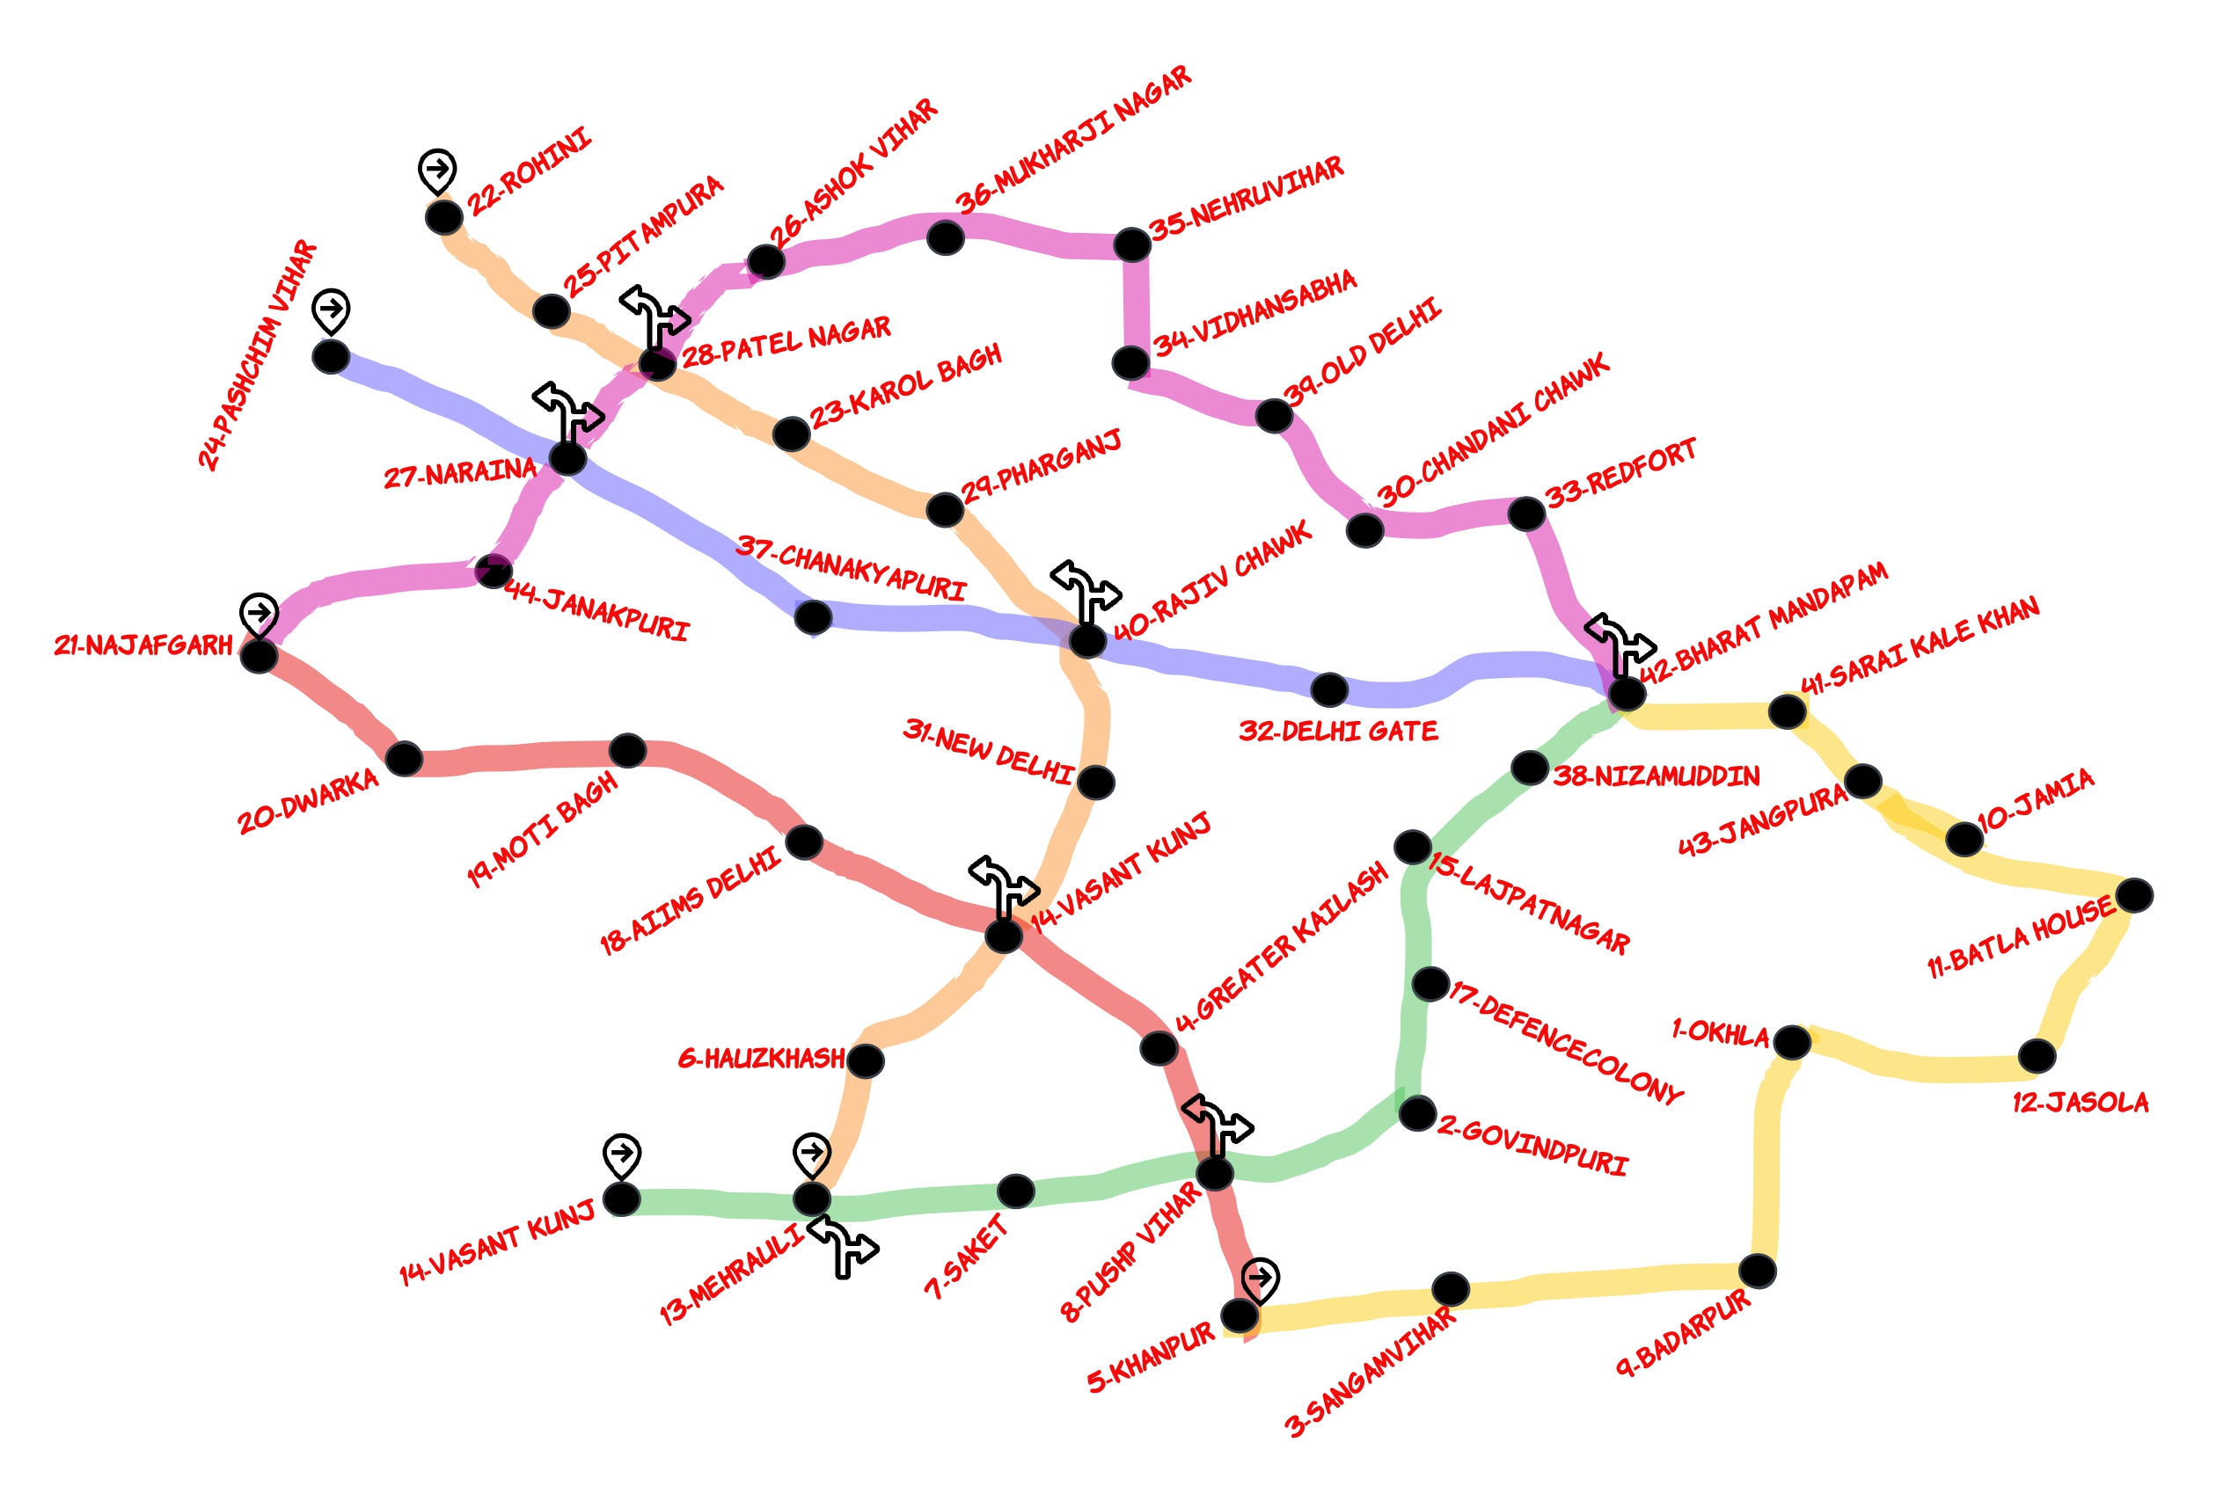
DMR MAP

Slide 4
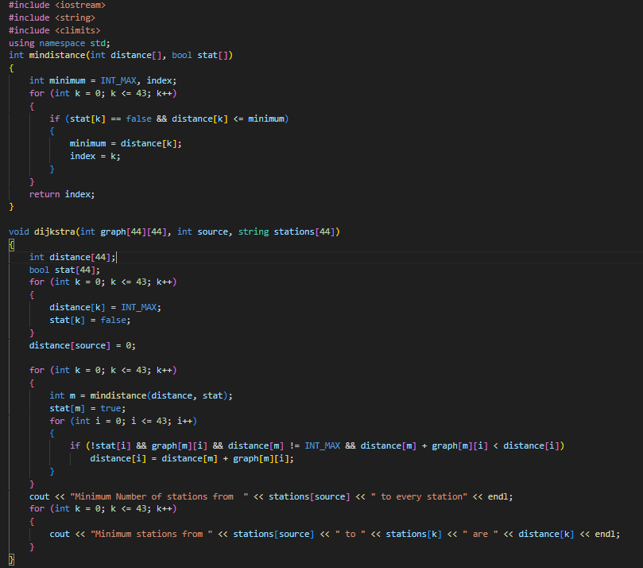
Implementation and code

Slide 5
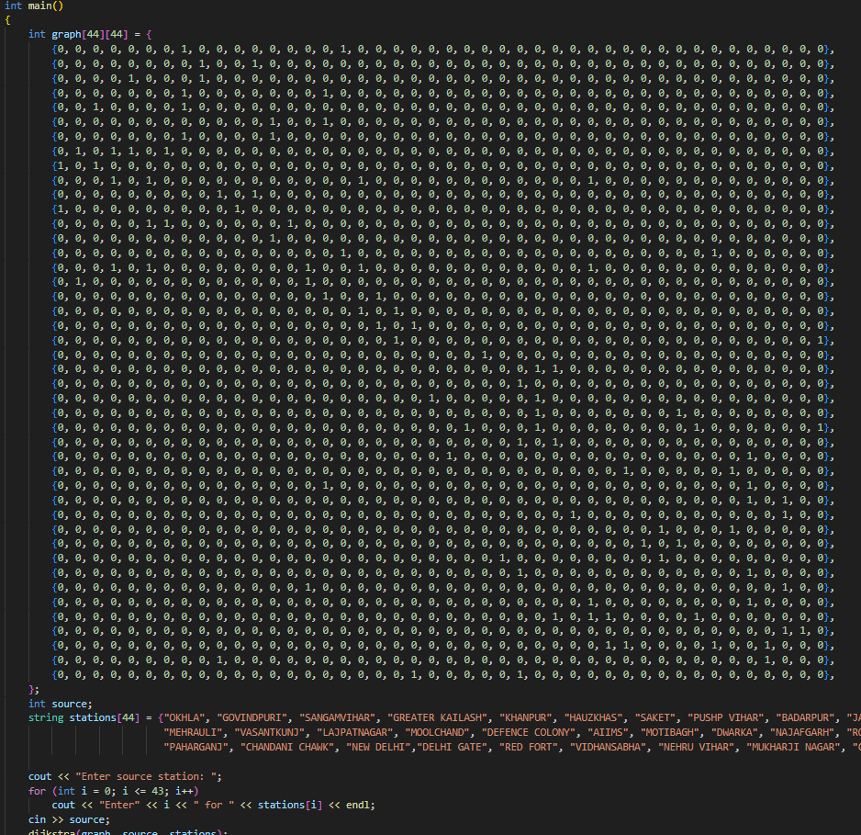
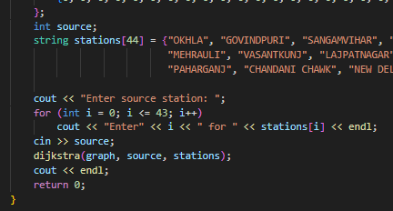
Implementation and code

Slide 6
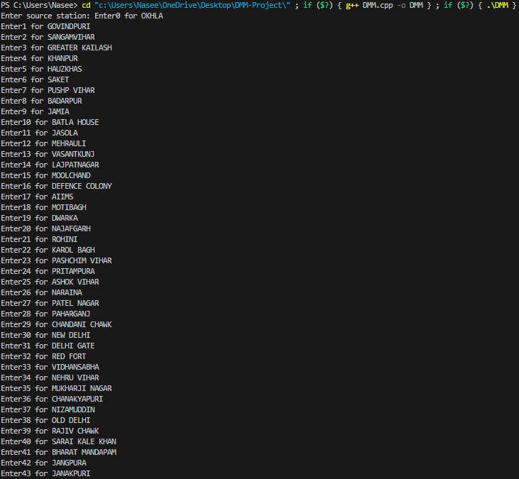
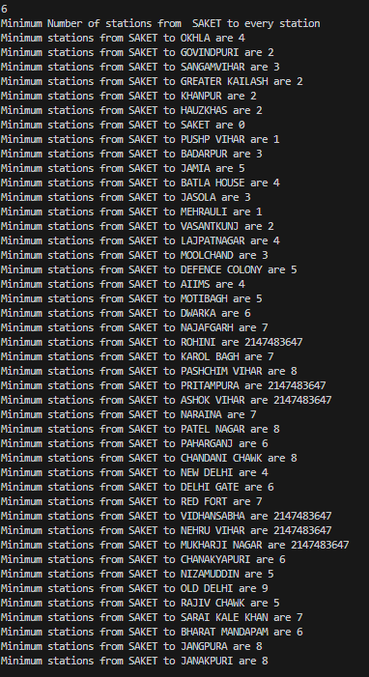
output

